Slide 1
STOCK PRICE PREDICTION OF BANKS USING MACHINE LEARNING
BALAJI
121923901002
AMMAN NAIDU
121913901004

Slide 2
COLLECTING DATA
Stock Data
Macro Economic Factors
GDP
Unemployment Rate
Inflation Rate
Consumer Confidence
Consumer Price Index
Gold price
Yield Value Of 10 Years bond

Slide 3
CLEANING DATA
Our data has different granularity so we while merging the data we found lot of NaN values by using interpolate we are able to remove the NaN values and arranged them in equal granularity
Merging Data
Slicing Data

Slide 4
OUTPUT
<class 'pandas.core.frame.DataFrame'>
DatetimeIndex: 7620 entries, 1999-01-01 to 2019-11-11
Data columns (total 11 columns):
BOA_CLOSE 7620 non-null float64
JPM_CLOSE 7620 non-null float64
CITY_CLOSE 7620 non-null float64
WELLS_CLOSE 7620 non-null float64
INFLA_RATE 7620 non-null float64
GDP_VALUE 7620 non-null float64
UNEMPLO_RATE 7620 non-null float64
CC_VALUE 7620 non-null float64
CPI_VALUE 7620 non-null float64
GOLD_CLOSE 7620 non-null float64
YIELD_VALUE 7620 non-null float64
dtypes: float64(11)
memory usage: 1.0 MB

Slide 5
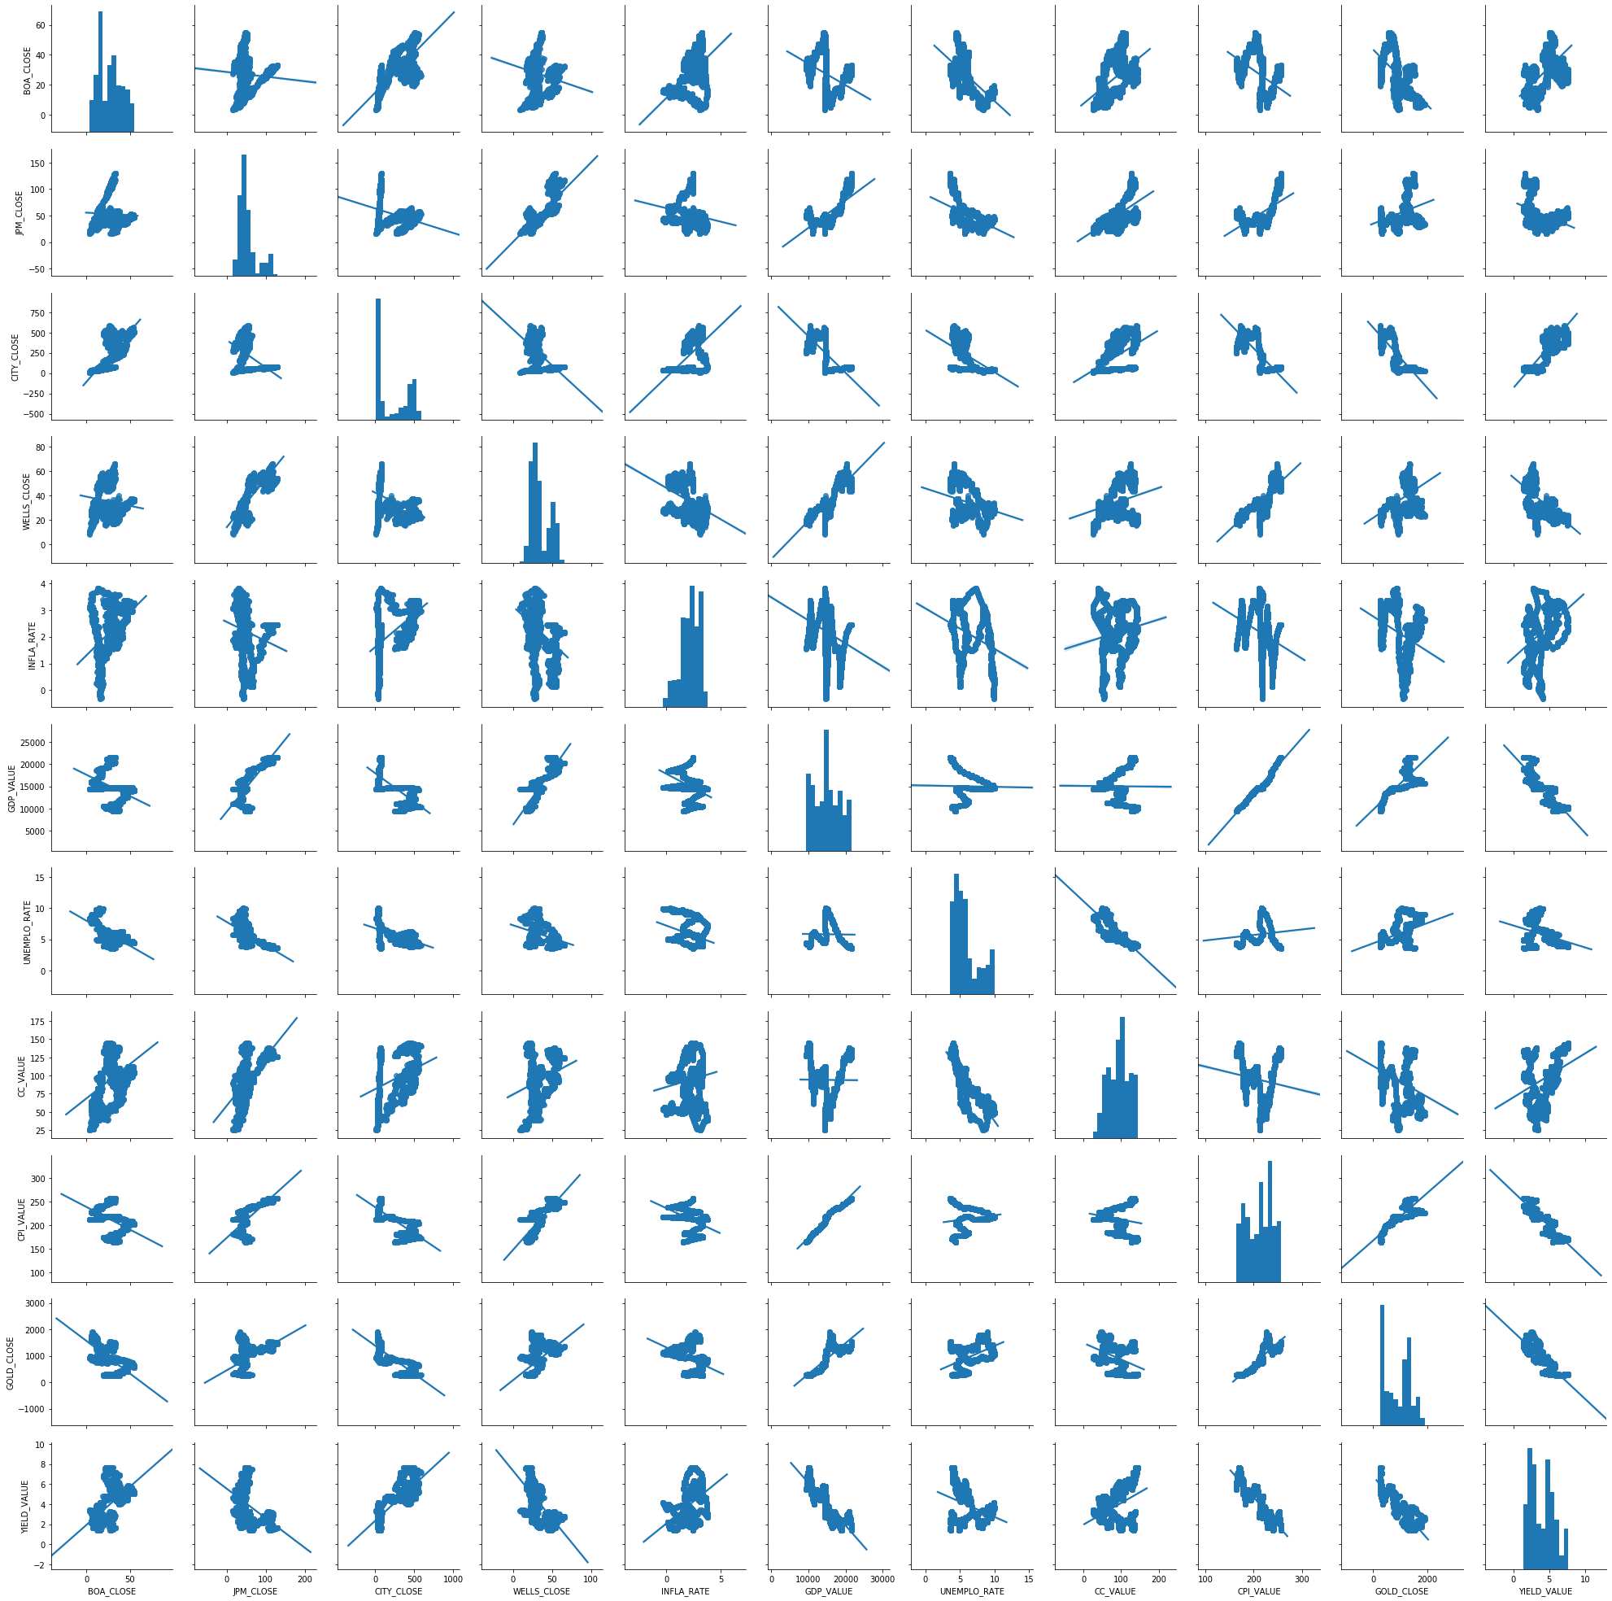
VISUALIZING THE DATA:

Slide 6
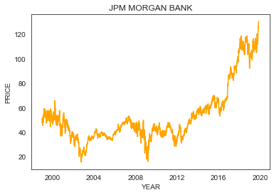
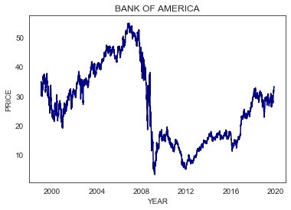
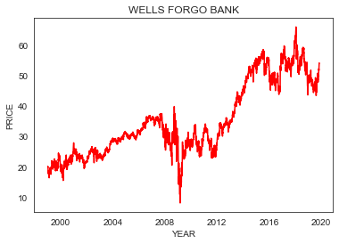
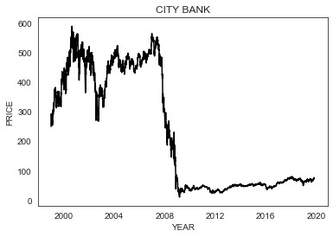
SCATTER PLOTS

Slide 7
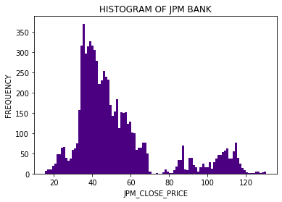
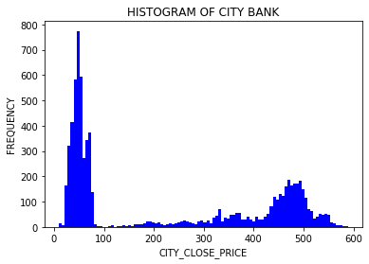
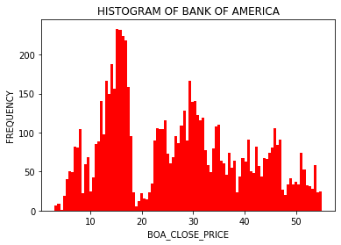
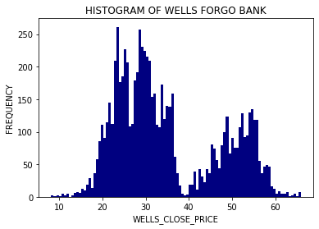
HISTOGRAM PLOTS

Slide 8
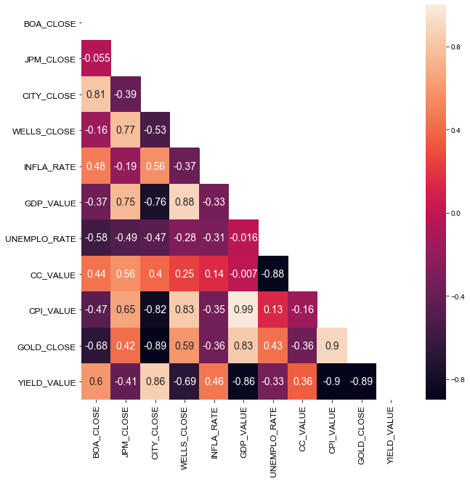
CORRELATION PLOT

Slide 9
SPLITTING DATA
from sklearn.model_selection import train_test_split
x2=data[['JPM_CLOSE']]
y2=data.drop(['BOA_CLOSE', 'JPM_CLOSE', 'CITY_CLOSE','WELLS_CLOSE'],axis=1)
x_train2,x_test2,y_train2,y_test2=train_test_split(y2,x2,test_size=0.2,random_state=0)
BUILDING MODEL
regression2.fit(x_train2,y_train2)
print(pandas.DataFrame({"index":x_train2.columns,"coeff":regression2.coef_.tolist()[0]}))
pandas.DataFrame(data=regression2.coef_,index=['coefficient'],columns=x_train2.columns)
print("intercept:",regression2.intercept_)
print('R^2 train dataset:',regression2.score(x_train2,y_train2))
print('R^2 test dataset:',regression2.score(x_test2,y_test2))

Slide 10
OUTPUT
index coeff
0 INFLA_RATE - 0.941970
1 GDP_VALUE 0.013303
2 UNEMPLO_RATE 1.701889
3 CC_VALUE 0.381072
4 CPI_VALUE -0.871155
5 GOLD_CLOSE 0.004967
6 YIELD_VALUE 4.657317
intercept: [-28.65914051]
R^2 train dataset: 0.9002138646376936
R^2 test dataset: 0.9067647947946865

Slide 11
EVALUATING THE MODEL
import statsmodels.api as sm
x2_include_constant=sm.add_constant(x_train2)
model2=sm.OLS(y_train2,x2_include_constant)
results2=model2.fit()
results2.params
results2.pvalues
print(pandas.DataFrame({"Coeffiencients":results2.params,"P-Values":round(results2.pvalues,2)}))

Slide 12
OUTPUT
Coeffiencients P-Values
const -28.659141 0.0
INFLA_RATE -0.941970 0.0
GDP_VALUE 0.013303 0.0
UNEMPLO_RATE 1.701889 0.0
CC_VALUE 0.381072 0.0
CPI_VALUE -0.871155 0.0
GOLD_CLOSE 0.004967 0.0
YIELD_VALUE 4.657317 0.0
By above results we found all the variables are significant to the target value.

Slide 13
CHECKING FOR MULTI COLLINEARITY:
CODE:
from statsmodels.stats.outliers_influence import variance_inflation_factor
VIF=[]
for i in range(0, len(x_include_constant.columns)):
VIF.append(variance_inflation_factor(exog=x_include_constant.values,exog_idx=i))
print(VIF)
print(pandas.DataFrame({"coeffients":x_include_constant.columns,"VIF":np.around(VIF,3)}))

